Slide 1
Who's taking Dad on Thursday?
Kindred
Take Dad to physio
?
Thursday, 2:00 pm · Nobody has claimed this
productBC buildathon Demo Day, 17 October 2026
Notes:
Speaker 1. Open with the question on screen and let it land. Then: "In most families, one sibling knows the answer and everyone else is guessing." The dashed question mark is Kindred's own symbol for a task nobody has claimed; we answer it on the insight slide.

Slide 2
Everyone reacted. Nobody went.
Ada
Can someone take Dad to physio on Thursday?
One sibling becomes the coordinator. Everyone else helps through a group chat, where a thumbs-up isn't a yes.
👍 👍 ❤️
Friday
Jonah
Did anyone take Dad to physio?
Maya
I thought you were going.
About 6.7 million Canadians give unpaid care to adults.
Statistics Canada, 2022
Notes:
Speaker 1, about 45 seconds. The chat on the right is an illustration, not a real conversation. Walk through it: the request gets reactions, nobody claims it, and the appointment is missed. Tasks get buried, appointments are missed or doubled up, and the real cost is burnout and resentment between siblings.

Slide 3
37% of family caregivers spend 11+ hours a week just coordinating care.
Before any hands-on care. From a 2026 survey of 272 US family caregivers.
Published survey: 272 US caregivers
Our AI-persona pilot (synthetic)
1 in 3
say their care feels fragmented
19 of 30
had care slip in the last three months
26%
say coordination is where tech could help most
3.8/5
average stress when care slipped
Caregiver Action Network, Caregiver Tech Insights Survey: Findings Report 2026 (272 US family caregivers, ±5.94%). Synthetic pilot: 30 survey responses written by AI personas, 14 October 2026. Not real caregivers.
Notes:
Speaker 1, about 45 seconds. Two sources, side by side. Left, in green, is real published data: Caregiver Action Network's 2026 survey of 272 US family caregivers. Say "a US survey found", never "we found". Its limits: US respondents, from a caregiver nonprofit's email list, not specific to siblings. Right, in marigold, is our synthetic pilot: AI personas answering our survey, not real people. Say "AI personas" out loud. The 26% is the share who said coordinating appointments, medications and family communication is where technology could help most, second only to safety monitoring at 28%. Once real survey results come in, replace the right-hand column and change those figures to dark green (#2F6B57).

Slide 4
What we heard, and what we built
We heard (synthetic pilot) | We built
An appointment buried in texts was missed | Reminders before every appointment and due task
When someone cancels, cover falls back on the coordinator | Ask for cover in one tap, shared to the family chat
One sibling holds it all in their head | A weekly summary of who did what
“The most stressful part of caregiving is trying to coordinate everything at once, appointments, medications, and daily care, while still managing my own responsibilities.”
A family caregiver in Caregiver Action Network’s 2026 survey
Notes:
Speaker 1, about 30 seconds (part of the validation minute). The left column comes from our synthetic AI-persona interviews, not real people, and the slide says so. The quote is real: an anonymised caregiver in Caregiver Action Network's 2026 survey. This slide shows product thinking: each problem maps to something we built. The US survey backs the same theme: nearly 1 in 3 caregivers say care feels fragmented, with information scattered across systems. Replace the left column with real interview findings once they exist.

Slide 5
A chat records what was said. Kindred records who said yes.
?
Every task has a named owner, so care stops slipping and no one carries it alone.
Take Dad to physio
M
Thursday, 2:00 pm · Maya claimed this on Tuesday
Thursday, 2:00 pm · Nobody has claimed this
Notes:
Speaker 2, about 15 seconds. Click once: the question mark from the cover becomes Maya's avatar. That's the root cause and the fix in one moment. Families do care, but a thumbs-up isn't a commitment. Kindred turns care into tasks that someone claims.

Slide 6
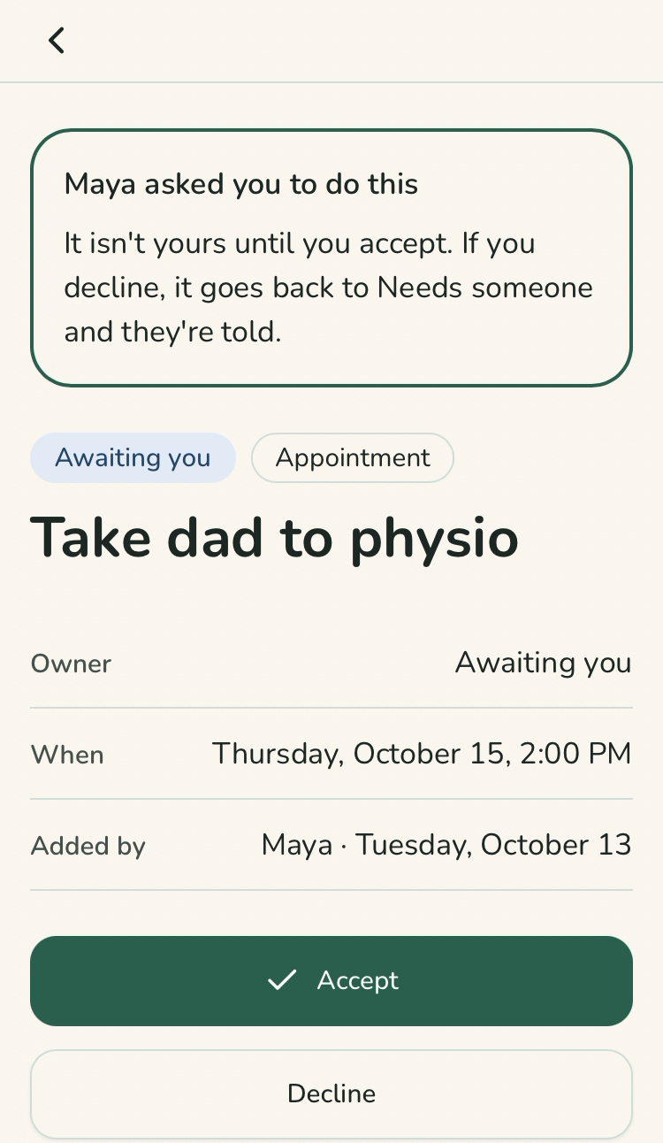
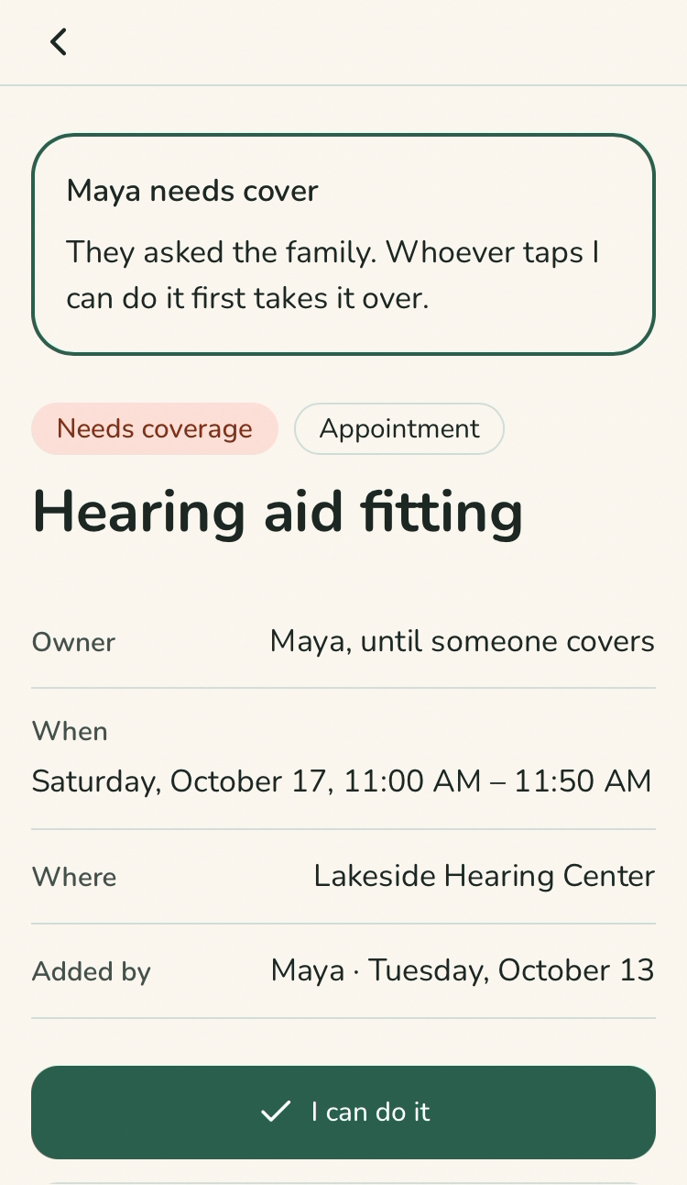
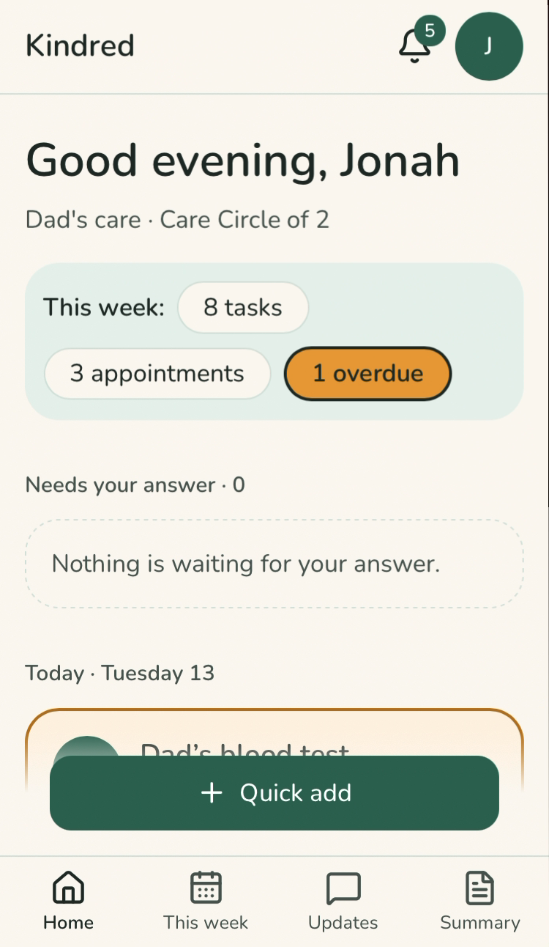
Simple enough for every relative
Claim, don't assign
It isn't yours until you accept.
One tap: yes or no
Helpers join free and just tap Accept.
Work with the chat
Share requests to WhatsApp. Sync with Google Calendar.
Never clinical
Kindred coordinates care. It gives no medical advice.
Notes:
Speaker 2, about 30 seconds. Give the reason behind each decision. Claim instead of assign, because ownership has to be agreed to. One tap, because "my brother won't use another app." Work with WhatsApp and Google Calendar, because that's where families already are. Not clinical, to keep trust and avoid liability. The screens are from the working app, the same ones the judges will see in the demo. If asked about the design process: we started from 31 wireframes, then built the finished design. Evidence if asked: in Caregiver Action Network's 2026 survey of 272 US caregivers, 23% would rather use text or email than download an app, and 26% are open to apps only if they're easy to set up.

Slide 7
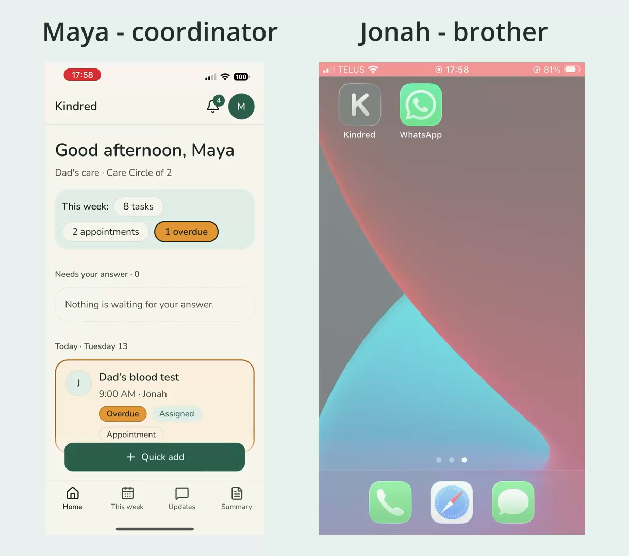
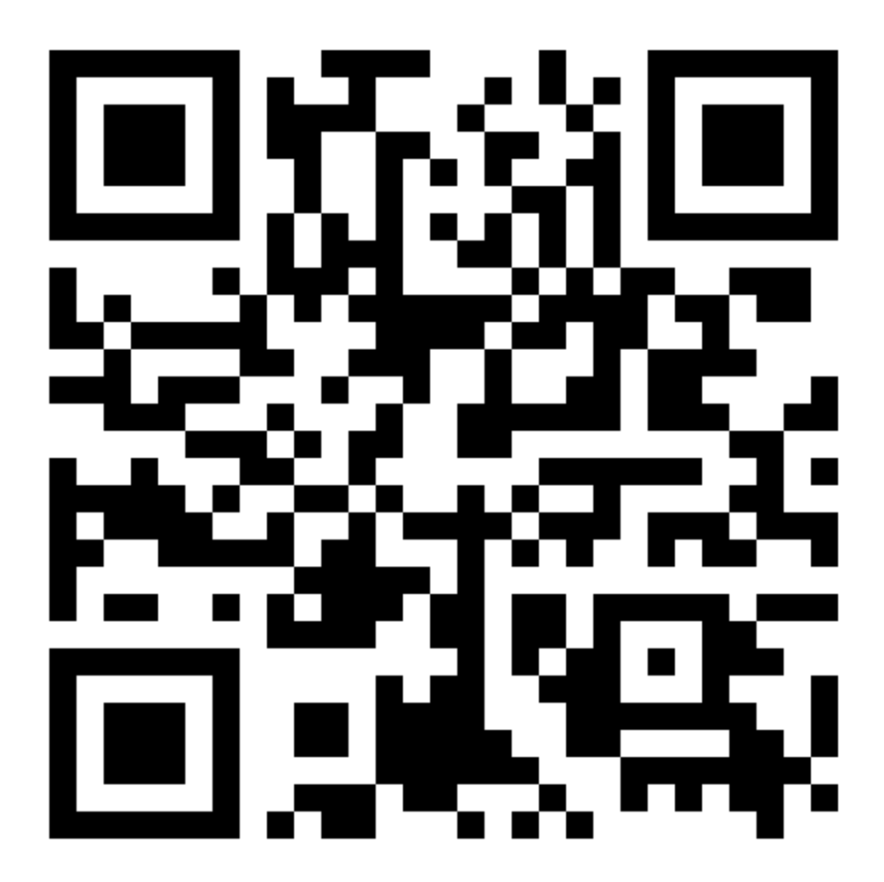
The core loop, on two phones
Create a recurring task for Dad
A sibling claims it
Plans change: ask for cover
Share the request to the family chat
Someone else takes it
Mark it done, with an update
[QR code]
Try it on your phone
kindred-care-circle.vercel.app
Tap Try the demo. No account needed.
Notes:
Speakers 2 and 3, about 2 minutes 30 seconds. Run the loop on two phones with the app on the Home Screen. Close with 10 seconds on the weekly summary (shown here) and the Free/Busy calendar check. Leave this slide up so judges can scan the code and join a sample Care Circle. Replace the dashed marigold box with the real QR code once the URL is final. Backup: the recorded demo video.

Slide 8
The coordinator pays. Everyone they invite is free.
28% of caregivers would pay $11–25 a month for a tool that reduces their stress. We start at $5.
Caregiver Action Network, Caregiver Tech Insights Survey 2026 (272 US family caregivers)
$5 a month
for the first 100 founding families, locked in, with a 30-day money-back guarantee and personal setup.
After that, $7 a month or $70 a year per Care Circle. Helpers never pay.
Paid from day one, so we learn early whether families value it.
Notes:
Speaker 4, about 20 seconds. The coordinator feels the pain and pays; everyone they invite is free, so adoption isn't blocked. "Why pay when the group chat is free?" Founding families get their money back if Kindred doesn't help in 30 days. Evidence: in Caregiver Action Network's 2026 US survey, 28% would pay $11–25 a month for a tool that reduces stress, and we start at $5. If a judge pushes on price: only 12% would pay out of pocket and 32% say tools should be free. That's the risk, and it's why helpers are free, founding families get a money-back guarantee, and the pilot has to prove value.

Slide 9
420,000 Canadian families share a parent's care.
~2.2M circles
~$185M
All unpaid caregivers of adults
~420K circles
Working adults sharing a parent's care
~$35M
~8,400 circles
~$700K
Our 3-year target, 2% of those
Bars to scale. Yearly revenue at $84 per circle; assumes 3 caregivers per circle and that 60% of working caregivers share care with family. Statistics Canada (2022); CCCE, Caring in Canada (2026).
Notes:
Speaker 4, about 20 seconds. Count families, not people: one coordinator pays for a circle of about three. Point at the last bar: our 3-year target is a sliver of the market, 2% of the families who need this.

Slide 10
Meet coordinators where they ask for help
Where they are
Canadian caregiver Facebook groups, r/AgingParents and r/caregivers.
Two-week test, $0
Keep going if 5+ circles have 3+ members each and 2+ families have paid.
How we show up
Help first. A free "who does what" care roster template leads into Kindred.
Change course if fewer than 3 in 30 conversations lead to a trial.
How it spreads
We set up the first 20 circles by hand. Each brings 3–5 relatives who see it work.
A trusted organization’s recommendation is the #1 reason caregivers adopt a tool (131 of 272).
Caregiver Action Network, Caregiver Tech Insights Survey 2026 (272 US family caregivers)
Notes:
Speaker 4, about 20 seconds. Coordinators post in these groups at the moment of crisis: after a fall, a hospital discharge or a missed appointment. Founder-led and helpful, not advertising. The test has clear numbers for continuing or changing course. Evidence: in the same US survey, a trusted organization's recommendation was the #1 reason caregivers adopt a tool (131 of 272), ahead of ease of use and price. That's why our ask is introductions to elder-care organizations.

Slide 11
Families keep their chat. Kindred adds who said yes.
Today they use | Where it breaks | What Kindred adds
A group chat | Tasks get buried; no owner | Claimed tasks, shared back to the chat
Shared calendars | Shows when, not who agreed | Who said yes, and who's free to cover
To-do apps and spreadsheets | Not built for care | Claim, decline or ask for cover
Care apps like CircleCare and CaringBridge | Ask families to leave their chat | Works alongside it, plus a weekly summary
Notes:
Speaker 4, about 20 seconds. Kindred is additive: keep WhatsApp. The weekly summary of what happened and what's next has no real equivalent among the apps we looked at. If asked about CircleCare's contribution tracking: our weekly summary names who did what each week; a running tally over time isn't built yet.

Slide 12
Stop being the only one who remembers.
Next: 10–20 founding families, November to January
The one number we track
Our ask
Weekly circles where helpers, not just the coordinator, complete tasks
Introductions to caregiver groups and elder-care organizations
Notes:
Everyone, about 30 seconds. Speaker 4 gives the next step and the ask (for example Family Caregivers of BC or Alzheimer Society chapters); speaker 1 finishes on the line in the middle. Stay within 7 minutes.

